Slide 1
AMP Study Overview
A collaboration between HVTN and HPTN

Slide 2
AMP
Antibody mediated prevention (AMP)
“A phase 2b study to evaluate the efficacy of VRC01 broadly neutralizing monoclonal antibody in reducing acquisition of HIV-1 infection”¹

Slide 3
VRC01
VRC01 is the antibody being tested
“Discovered in an individual who was HIV infected for a long time (>15 years), who maintained virologic control on no ART”¹
“Broadly neutralizing human mAb that targets the HIV-1 CD4 binding site”⁴
mAb = monoclonal antibody (all made from same immune cells)
bnAb = broadly neutralizing antibody
“Conferred protection against simian-human immunodeficiency virus (SHIV) challenges in nonhuman primate (NHP) studies”³
Potent antibody
Shown by phase 1 trials to be safe (in both HIV infected and uninfected individuals)
Half-life is around 14 days

Slide 4
“The AMP Study: Objectives & Endpoints”¹
Safety & Tolerability of VRC01 infusion
Reactogenicity, AEs, SAEs, discontinuation rates
Efficacy to prevent HIV infection
HIV infection by week 80 in those HIV-negative at enrollment
Develop a marker(s) of VRC01 that correlates with the level and antigenic specificity of efficacy
Serum VRC01 concentration
Serum mAb effector functions
Breakthrough HIV viral sequences in infected people
VRC01 neutralization sensitivity of, & effector functions against, HIV strains from infected trial participants
PRIMARY
SECONDARY
Graphic from HVTN 703/HPTN 081 Protocol Overview (1)

Slide 5
Study Structure
2 separate protocols (very similar):
HVTN 704/HPTN 085 (Americas)
HVTN 703/HPTN 081 (sub-Saharan Africa)
14 cities in the U.S. (19 total clinics)
Peru (4 clinics) and Brazil (1 clinic)
Exact locations in Africa not specified (South Africa, Botswana, Zimbabwe, Kenya, Malawi, Mozambique, Tanzania)
Testing high risk people

Slide 6
Participant Break-down
Cohort | Antibody (VRC 01) 10mg/kg | Antibody (VRC 01) 30mg/kg | Placebo | Total Population
Americas: United States, Peru & Brazil MSM & TG people (Clade B) | 800 | 800 | 800 | 2,400
Southern Africa: South Africa, Botswana, Zimbabwe, Kenya, Malawi, Mozambique, Tanzania Heterosexual women (Clade C) | 500 | 500 | 500 | 1,500
Total | 1,300 | 1,300 | 1,300 | 3,900
Table from HVTN 703/HPTN 081 Protocol Overview (1)

Slide 7
HVTN 704/HPTN 085
Participants = “2700 HIV-1–uninfected MSM and TG who have sex with men or TG, aged 18 to 50 years, in North and South America”³
U.S. participants will receive PrEP (Truvada®) for free
Truvada® is not yet licensed in Peru and is in the progress of being licensed in Brazil
Assuming a “3% annual HIV-1 incidence in the North/South American MSM & TG placebo group against an assumed back ground PrEP use”¹
Assuming a “10% annual dropout incidence in each of the three study groups”¹

Slide 8
HVTN 703/HPTN 081
Participants = “in sub-Saharan Africa, 1500 women at risk of HIV-1 infection”⁴
No mention of PrEP treatment for this group
Assuming a “5.5% annual HIV-1 incidence in the sub-Saharan African women placebo group”¹
Assuming a “10% annual dropout incidence in each of the three study groups”¹

Slide 9
Treatment Specifics
IV: receive an IV over a 30-60 minute period every 8 weeks (10 times total)
Blood draw: undergo a blood draw at the clinic every 4 weeks (includes an HIV test)
STI testing: undergo STI testing (urine & rectal or cervicovaginal swabs) about every 6 months
Questionnaires: complete questionnaires about sexual behavior & general health every 4-8 weeks
STUDY DURATION: about 22 months
Graphic from HVTN 703/HPTN 081 Protocol Overview (1)

Slide 10
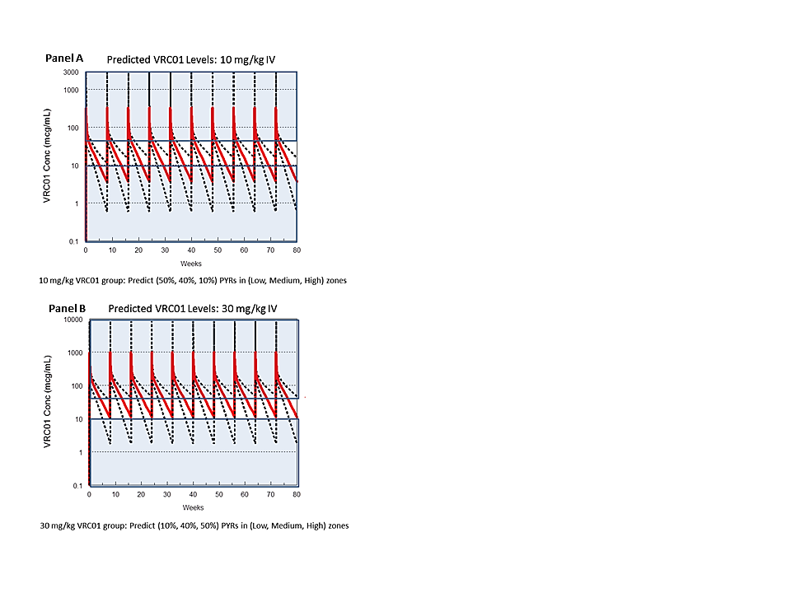
“Predicted VRC01 serum concentrations at 2 doses (10mg/kg and 30mg/kg)”¹
Charts from HVTN 703/HPTN 081 Protocol Overview (1)

Slide 11
Challenges/Things to Note
“A challenging aspect of dose/schedule selection for the AMP Study is that the serum level of VRC 01 required to protect against HIV infection in humans is unknown”¹
Subjects will be tested for HIV “at least every four weeks and at any time following participant report of possible exposure during the study”³
There will be uncertainty regarding exactly when the patient contracted HIV

Slide 12
Sources (from HVTN and HPTN)
1: HVTN 703/HPTN 081 Protocol Overview slides presented by Sri Edupuganti, MD MPH
2: AMP Update 3.pdf (a communication letter with updates on the study)
3: HVTN 704_HPTN 085_v0.07_RAB
4: HVTN 703_HPTN 081_Protocol Version

